Slide 1
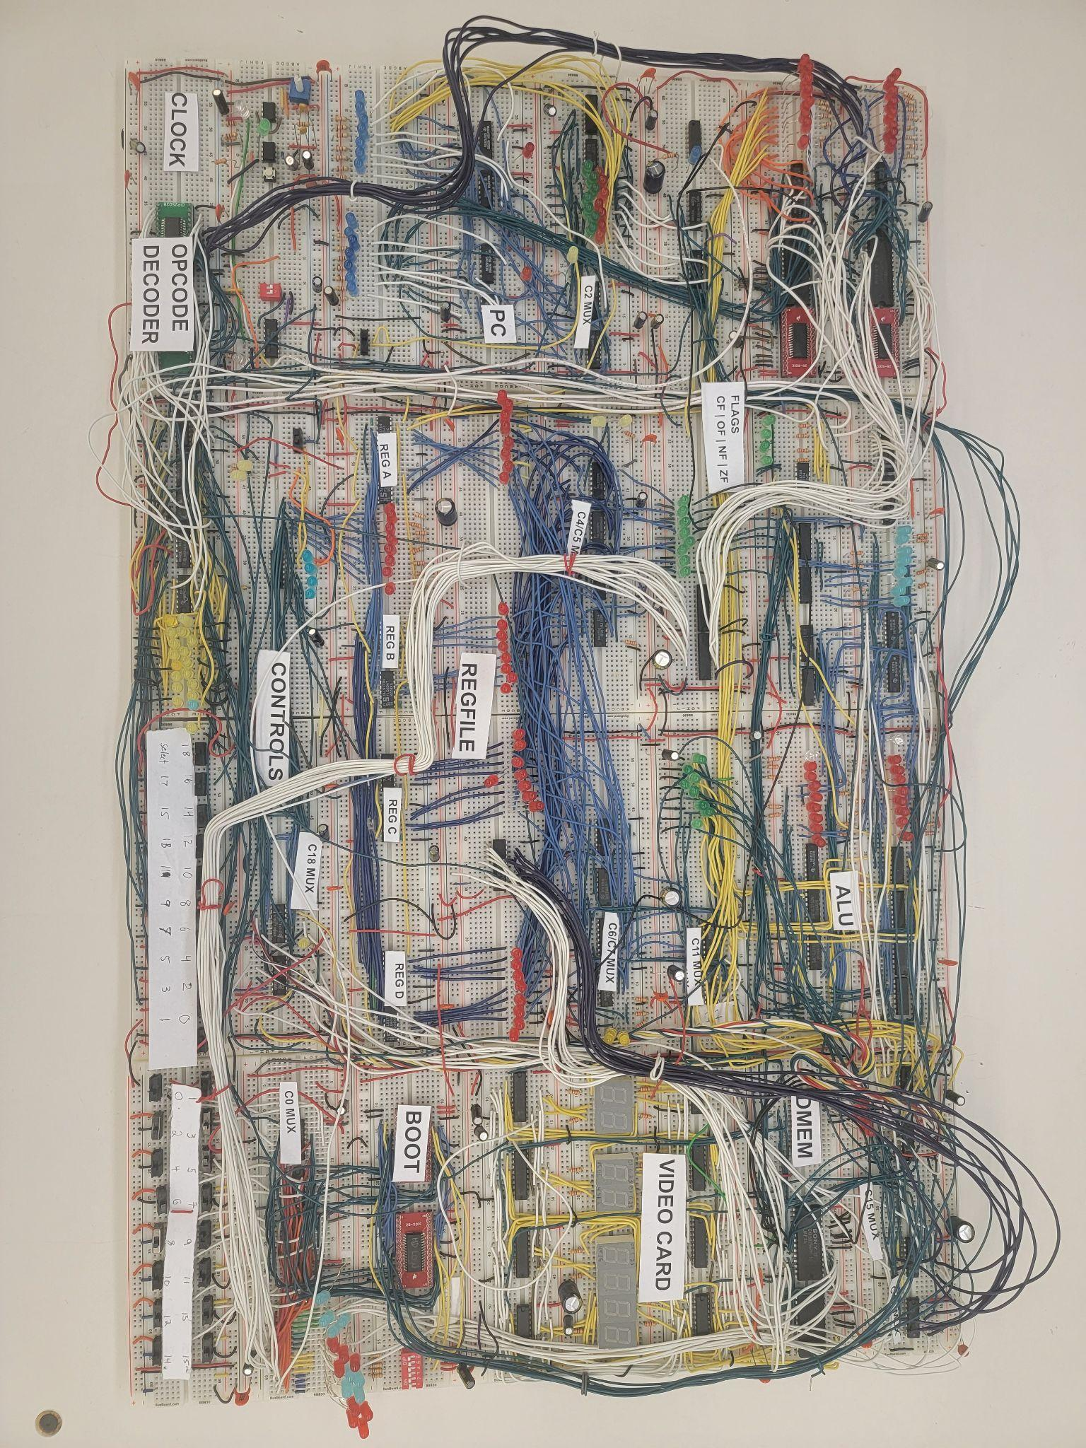
Implement the i281 CPU in Hardware
Team Name: sddec22-20
Advisor/Client: Dr. Alexander Stoytchev
Website: https://sddec22-20.sd.ece.iastate.edu/
Notes:
Speaker: Joe

Slide 2
Project Overview
i281 CPU: sddec22-20
Notes:
Speaker: Saffron

Slide 3
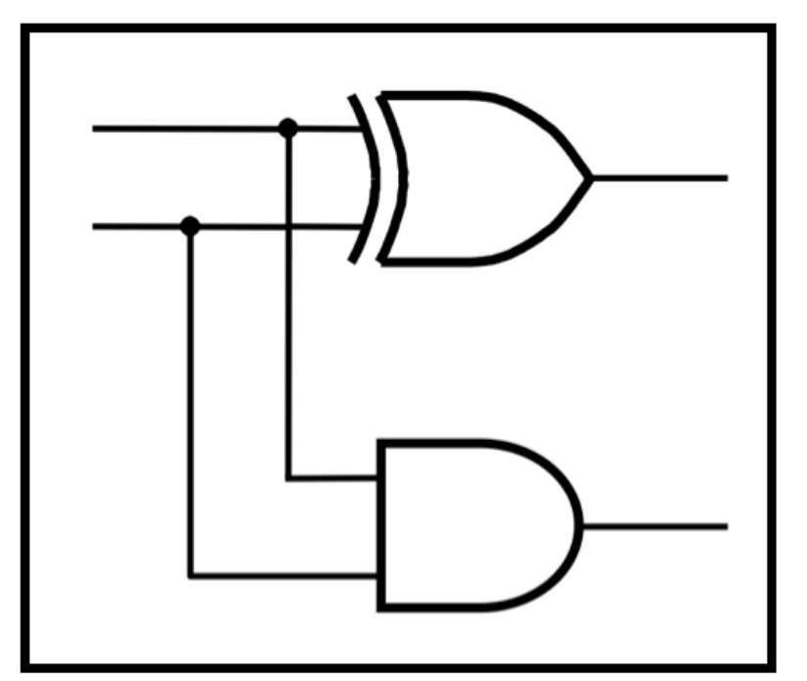
What is CprE 281?
“Boolean algebra and logic minimization. Combinational and sequential logic design. Arithmetic circuits and finite state machines. Use of programmable logic devices. Introduction to computer-aided schematic capture systems, simulation tools, and hardware description languages. Design of simple digital systems.”
i281 CPU: sddec22-20
Notes:
Speaker: Saffron

Slide 4
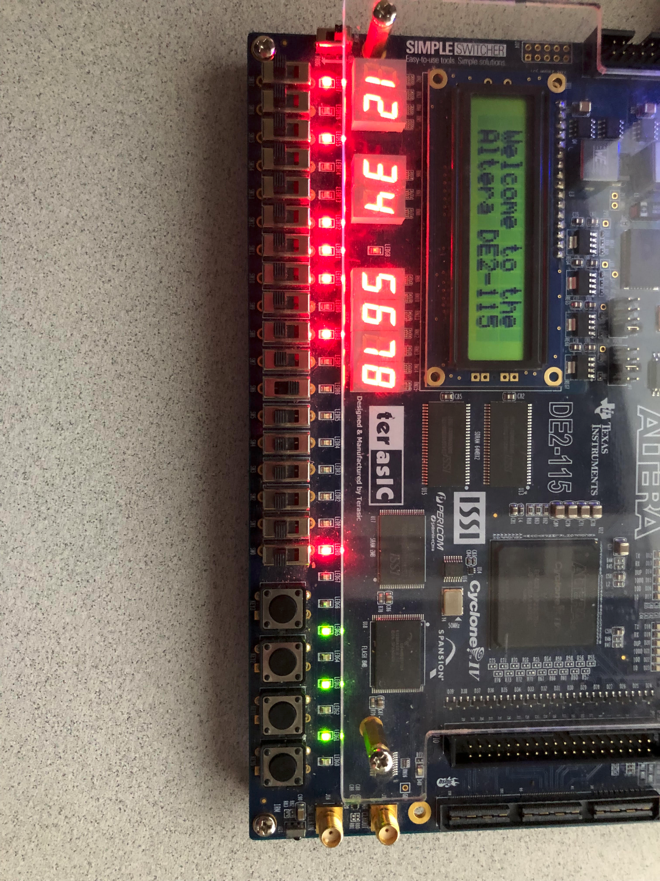
What is the i281 CPU?
The i281 CPU is an 8-bit microprocessor that was design to support the curriculum in CprE 281: Digital Logic. The CPU was designed as a teaching tool for this class.
Altera FPGA running Bubble Sort using the i281 CPU
i281 CPU: sddec22-20
Notes:
Speaker: Pat

Slide 5
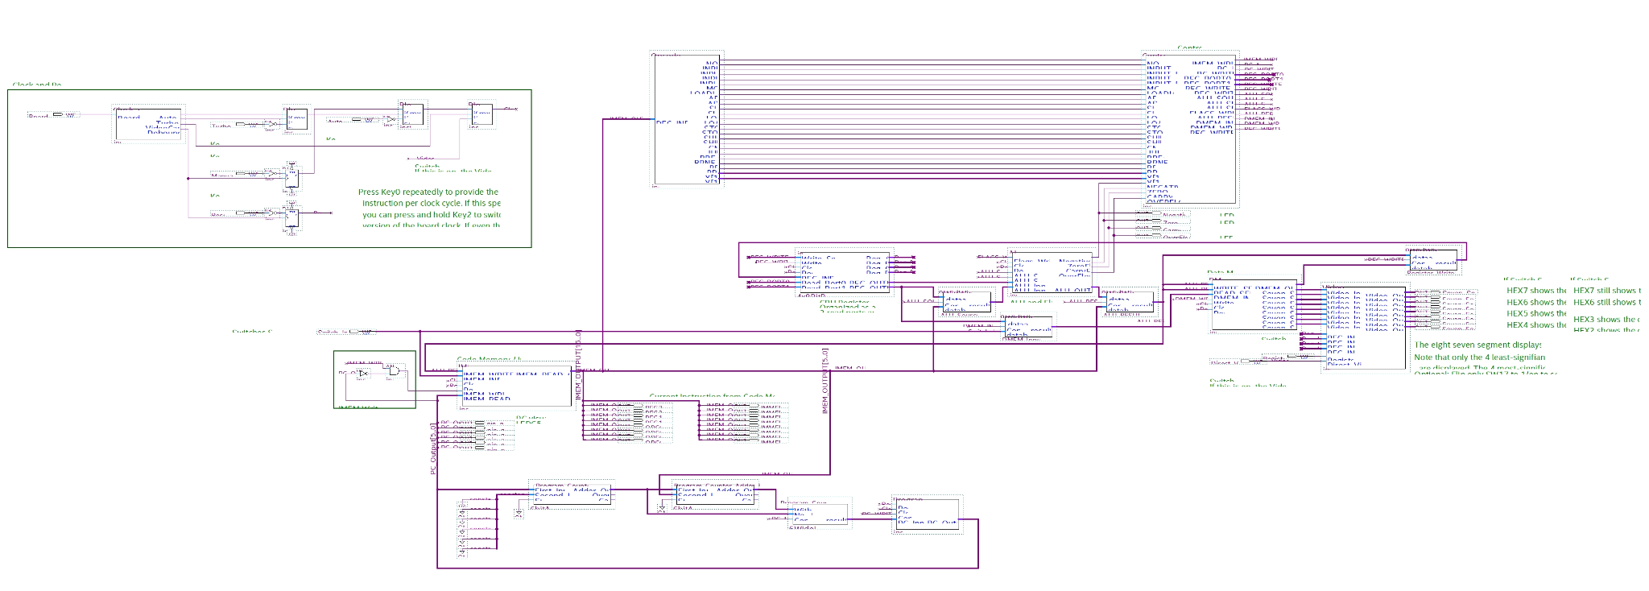
FPGA Design Overview
Designed by: Dr. Stoytchev and Kyung-Tae Kim
Notes:
Speaker: Pat

Slide 6
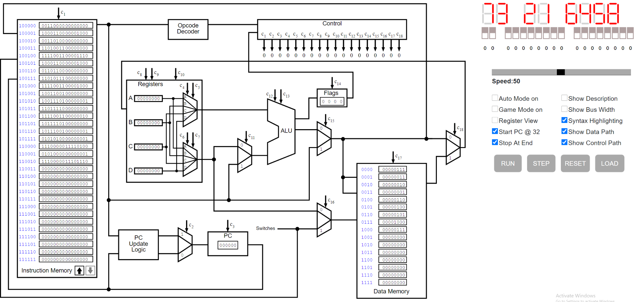
The i281 Simulator
Designed by: sdmay21-38
i281 CPU: sddec22-20
Notes:
Speaker: Joe

Slide 7
This Project’s Description In Its Simplest Form:
Software Version of the i281 CPU
Hardware version of the i281 CPU
i281 CPU: sddec22-20
Notes:
Speaker: AJoe

Slide 8
Project Description
(Long Version)
Hardware implementation of the i281 CPU
Help CPRE 281 students visualize a basic processor
Must maintain the original i281 CPU design and functionality
Use LEDs and 7 segment displays for visualization
Each instruction will have an easy to follow visual representation of data
Prototyped and debugged on breadboards
i281 CPU: sddec22-20
Notes:
Speaker: Alex

Slide 9
Pros and Cons for Three Different Implementations of the i281 CPU
Hardware
Pros:
Visual
Tangible
Demonstration of in class concepts in real life
Realistic
Cons:
Complicated to wire
Error prone during design
Expensive
FPGA
Pros:
Can be reloaded
Multiple FPGAs for students
Portable (run on multiple types of FPGAs)
Cons:
FPGA has limited memory
Not very visual nor tangible
FPGAs are expensive
Simulator
Pros:
Cheap
Visual
Can be updated
Cons:
Imperfect (bugs)
Not tangible
Needs website upkeep as well as simulator upkeep
Notes:
Speaker: David

Slide 10
Functional Requirements
Constraints
Demonstrate Program Execution
Easy to Visualize
Must Function Similar to Software and Field Programmable Gate Array (FPGA) i281 CPUs
Limited Budget
CPU must be Easy to Reproduce
Portable
Able to run all instructions in the instruction set architecture (ISA)
DIP Switch Inputs
7 segment display outputs
Variable Clock Speed and
Manual Clock
Reprogrammable
i281 CPU: sddec22-20
Notes:
Speaker: David

Slide 11
Non-Functional Requirements
Easy to visualize
Works similarly to the simulator & FPGA implementations
Limited budget
CPU must be easy to reproduce
Notes:
Speaker: David

Slide 12
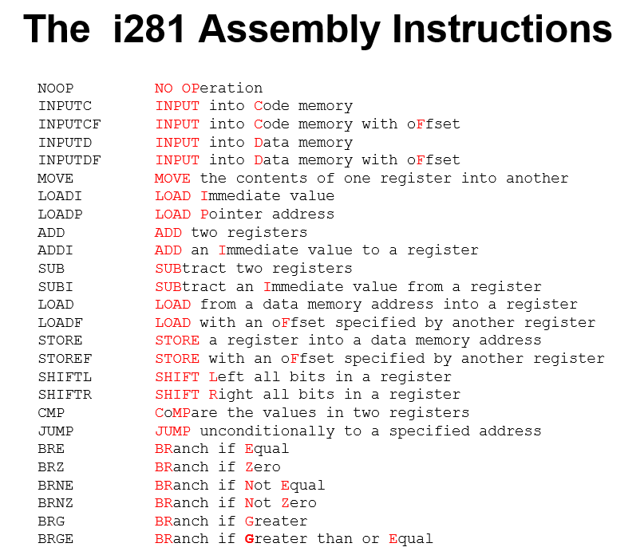
i281 CPU: sddec22-20
Notes:
Speaker: David

Slide 13
Technical Specifications of the Current Hardware i281 CPU
Execute 1 instruction every cycle
1 MHz clock
4-address x 8-bit registers
16-address x 8-bit DMEM
64-address x 16-bit IMEM
26 I/O devices
Power Consumption < 50 W
i281 CPU: sddec22-20
Notes:
Speaker: Saffron

Slide 14
Project Plan
i281 CPU: sddec22-20
Notes:
Speaker: Saffron

Slide 15
Project Milestones
Milestones | Stretch Goals
Design and build all subcomponents (ALU, Register File, Memory, Displays, Program Counter, Opcode Decoder) | Create PCB modules
Connect every subcomponent to create a datapath | Create PCB design based on the breadboard CPU
Test the datapath for basic functionality and continuity | Review and order PCB prototypes
Test datapath for functionality with PONG and Bubble Sort | Solder PCBs, combine and test for system bugs
i281 CPU: sddec22-20
Notes:
Speaker: Saffron

Slide 16
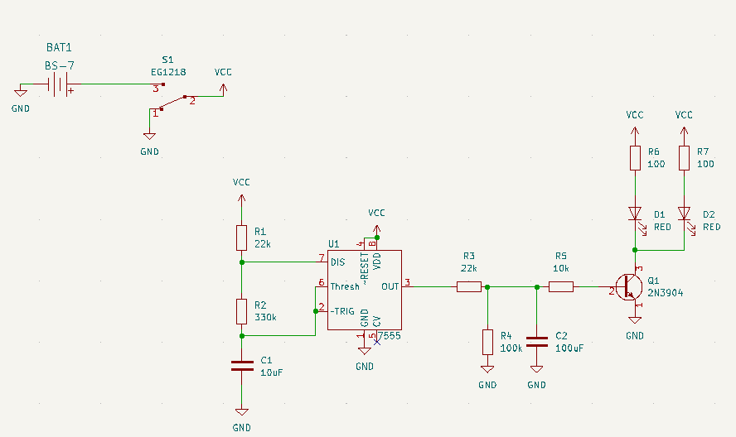
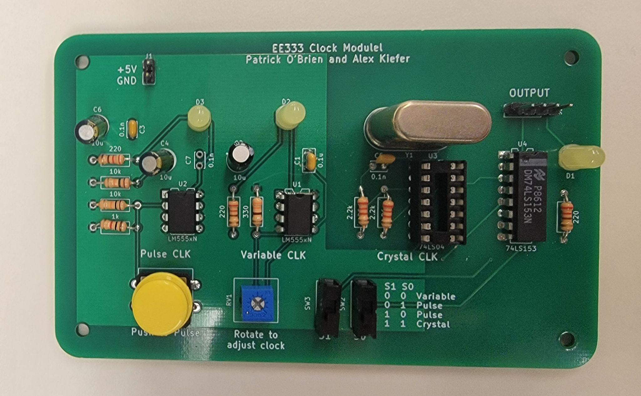
KiCad and the PCBs
We used KiCad to design the PCB implementation
Most of our team learned KiCad in preparation
Clock module was printed and soldered
All other modules were designed in KiCad
Time constraints = no finished PCB implementation
i281 CPU: sddec22-20
Notes:
Speaker: Pat

Slide 17
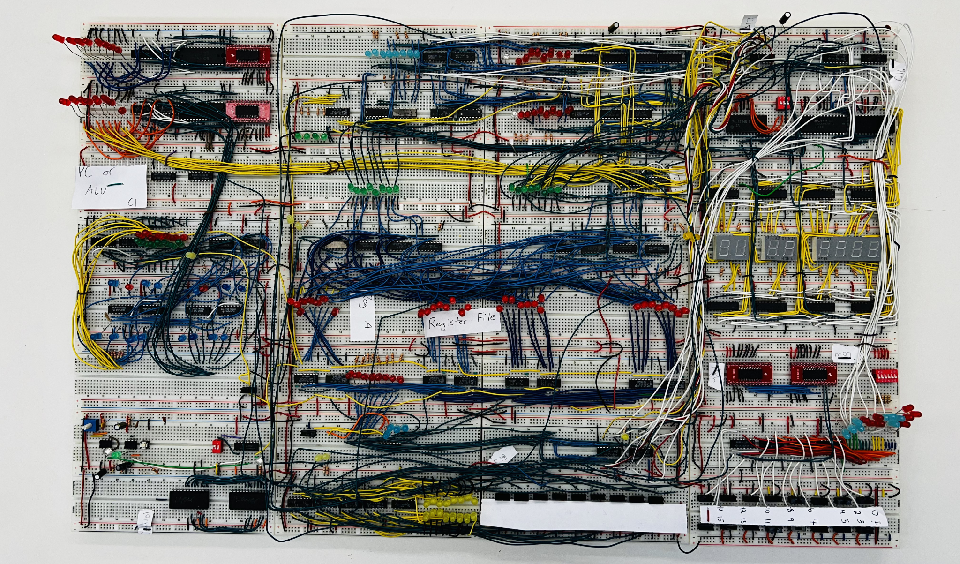
Resource/Cost Estimate
Notes:
Speaker: Pat

Slide 18
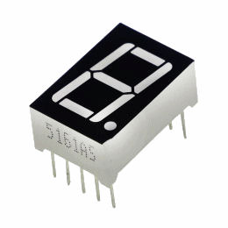
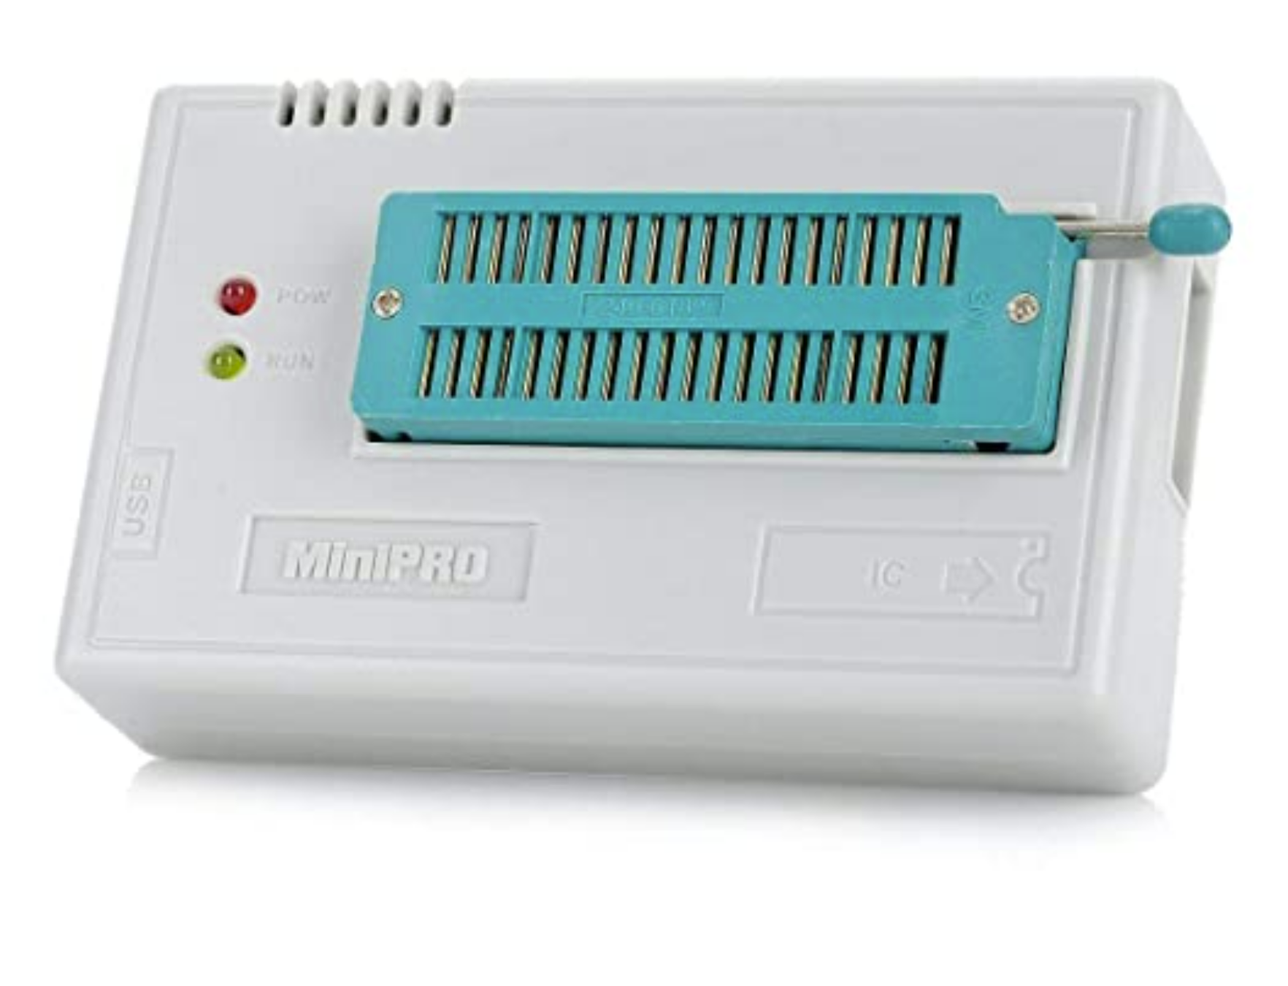
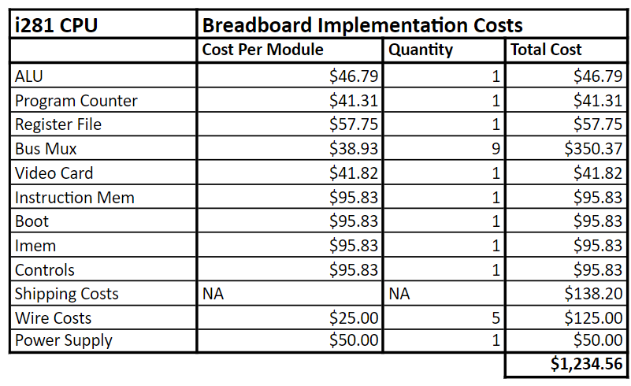
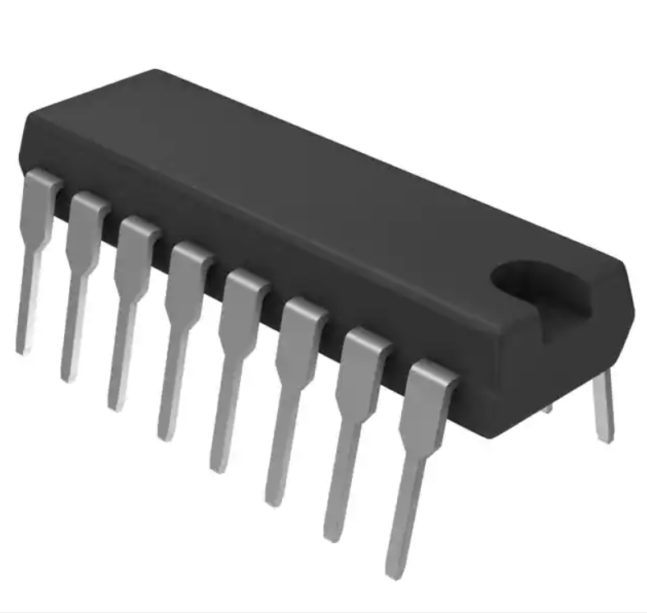
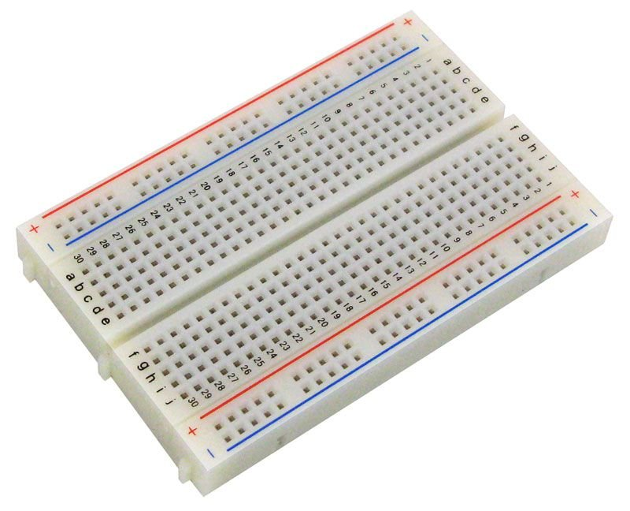
Resource/Cost Estimate Cont.
i281 CPU: sddec22-20
Notes:
Speaker: Pat

Slide 19
Potential Risks
Mitigation
LED Power Consumption
Chip Shortages
Breadboard Implementation
Low power LEDs and 50W Power Supply
Source Replacements
Modular and Proper Wiring
i281 CPU: sddec22-20
Notes:
Speaker: Alex

Slide 20
Test Procedure
Test Individual Components:
Clock Module
ALU
Register File
Data Memory
Instruction Memory
Program Counter
Test Datapath:
Develop test programs
Execute all normal Instructions
Execute branches/update PC
Load new programs
Run bubble sort
Run pong
i281 CPU: sddec22-20
Notes:
Speaker: Alex

Slide 21
Current System Design
i281 CPU: sddec22-20
Notes:
Speaker: Joe

Slide 22
Introduction to design approach
Design overall layout
Build Individual modules
Documentation
Testing
Create Full-implementation
Debugging
Testing
PCB CAD design
Notes:
Speaker: Joe mama

Slide 23
Full Implementation
Notes:
Speaker: Joe mama

Slide 24
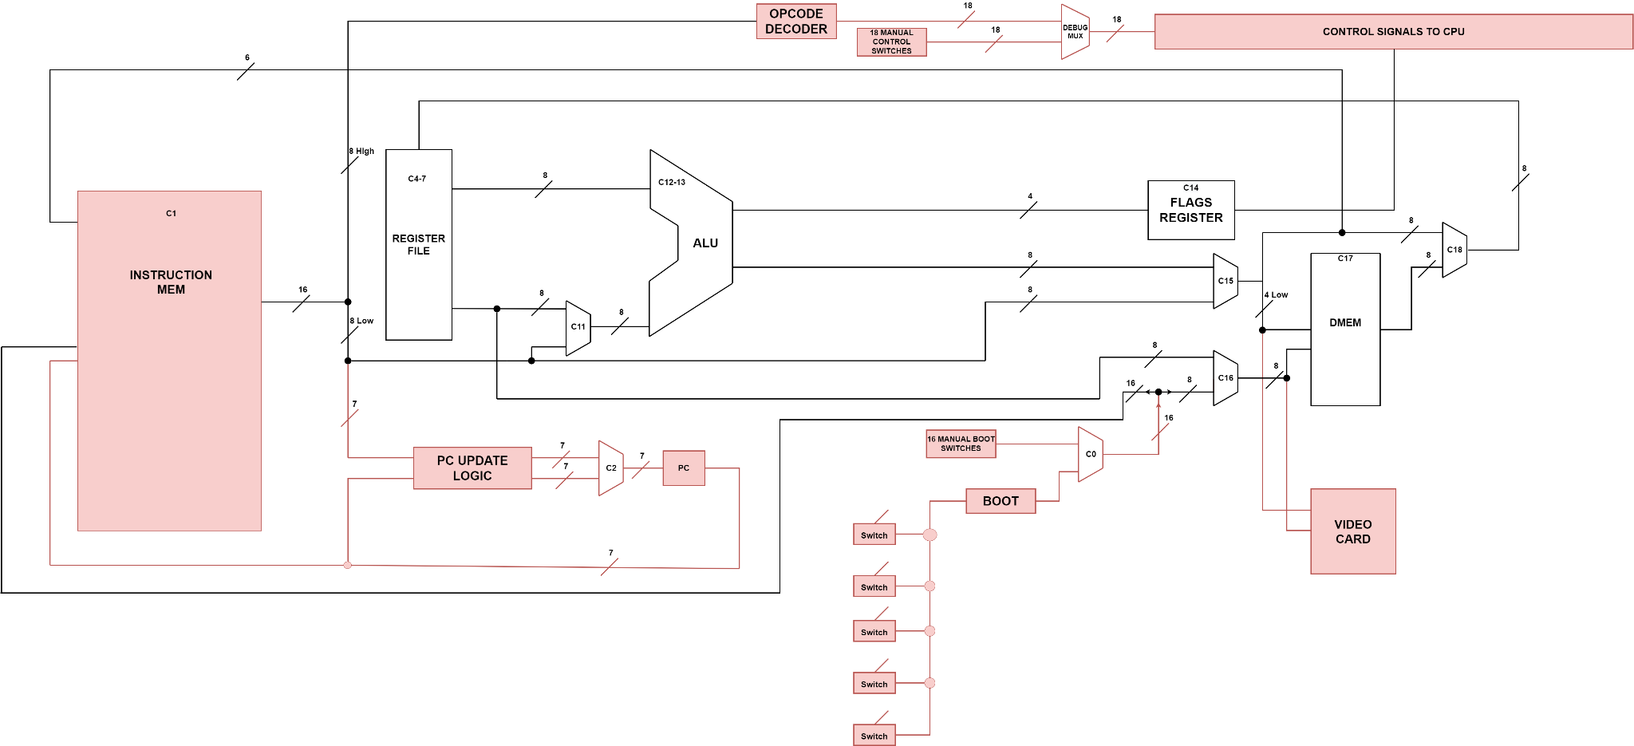
Full Implementation Diagram
Notes:
Speaker: Joe Mama

Slide 25
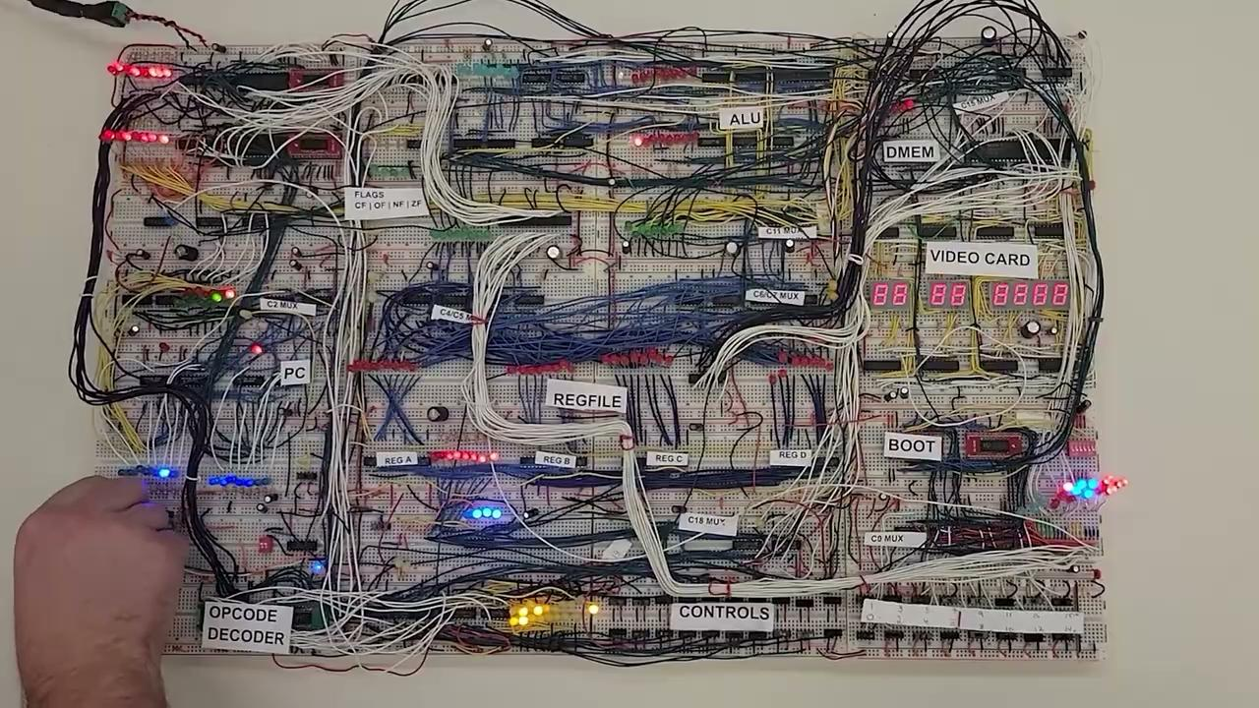
Demo Video of i281 Breadboard CPU
Notes:
Speaker: David

Slide 26
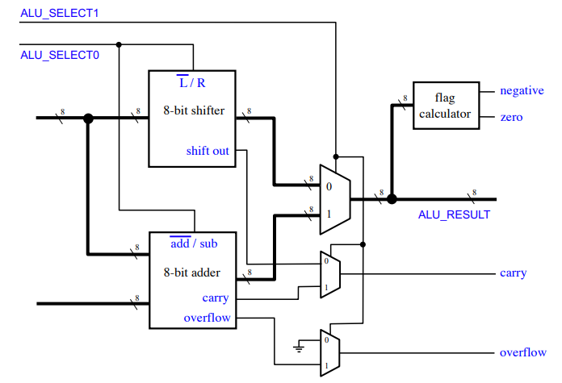
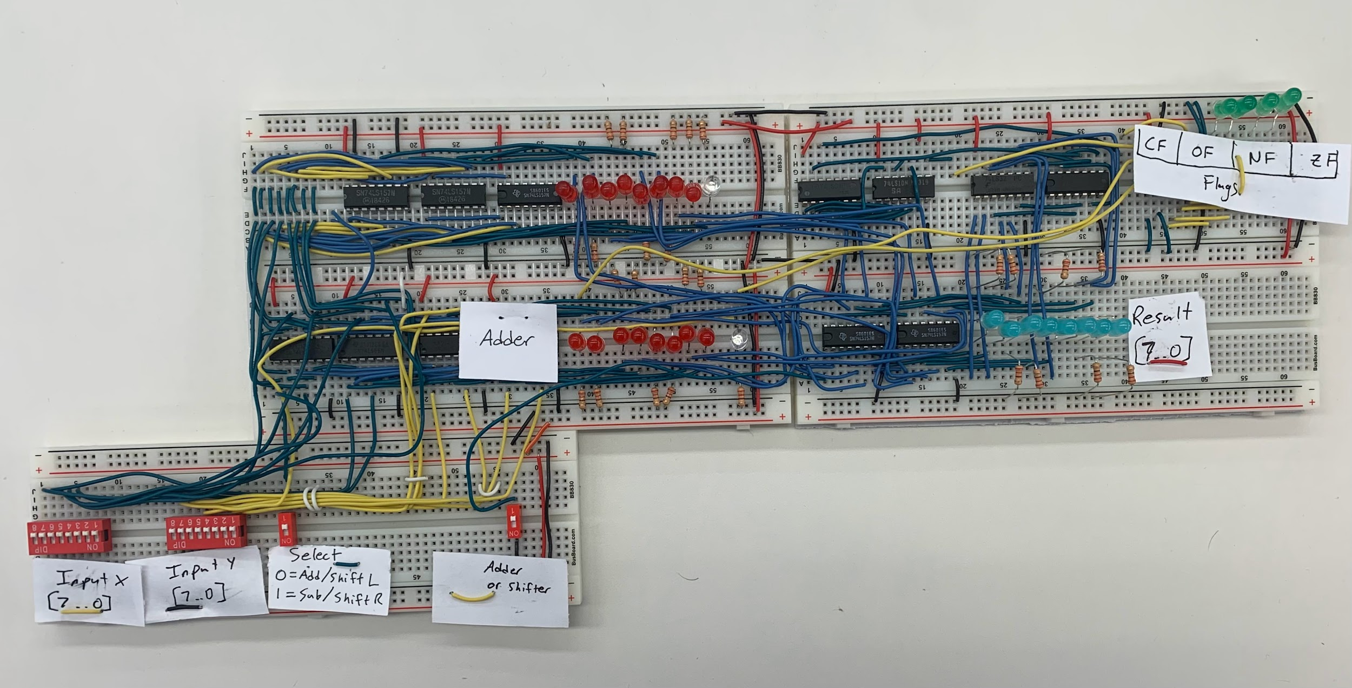
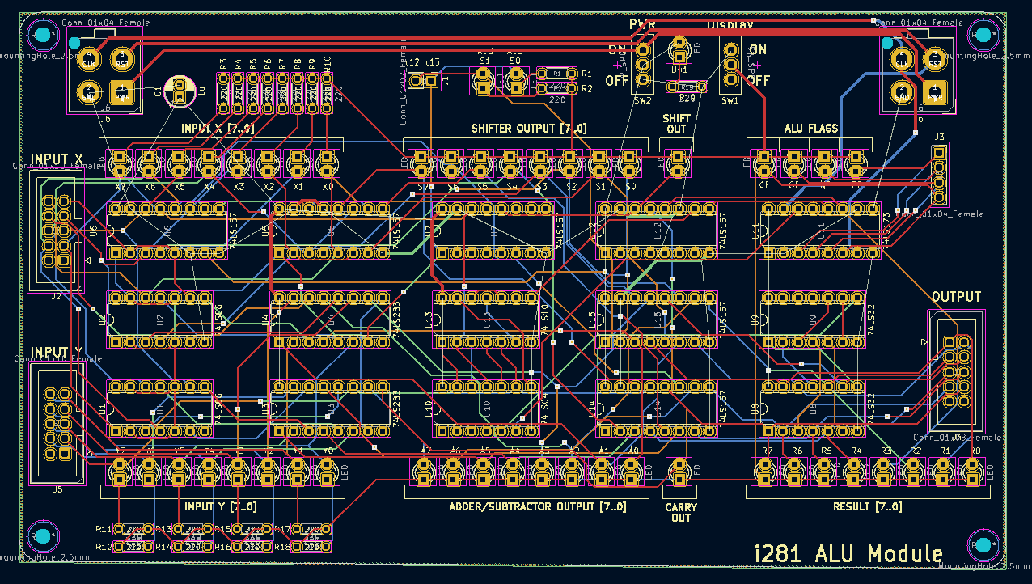
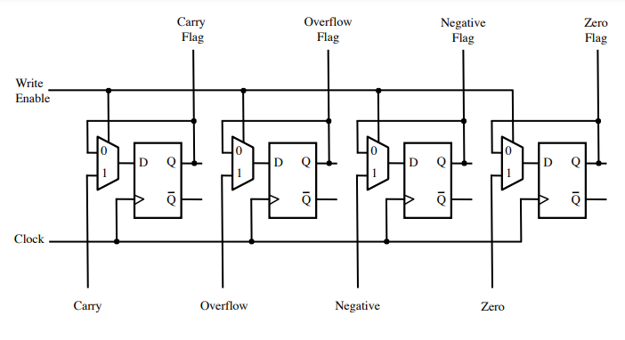
ALU and Flags Register
Notes:
Speaker: Pat

Slide 27
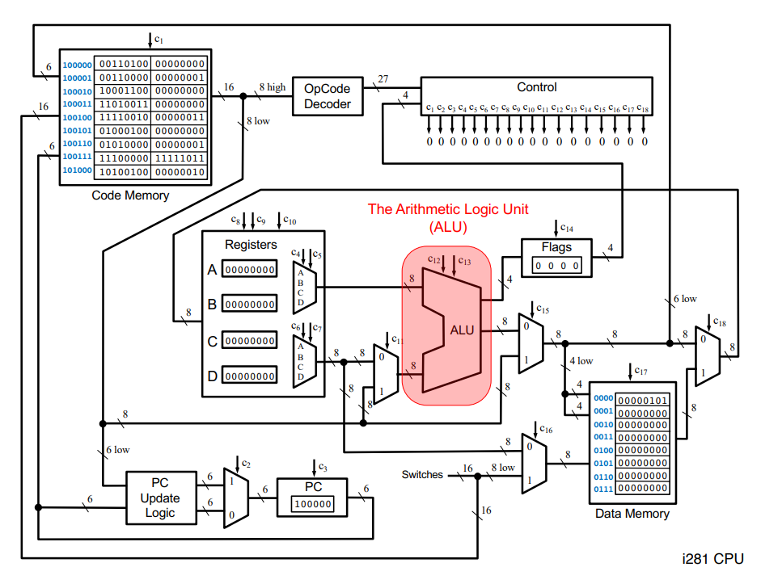
Notes:
Speaker: Pat

Slide 28
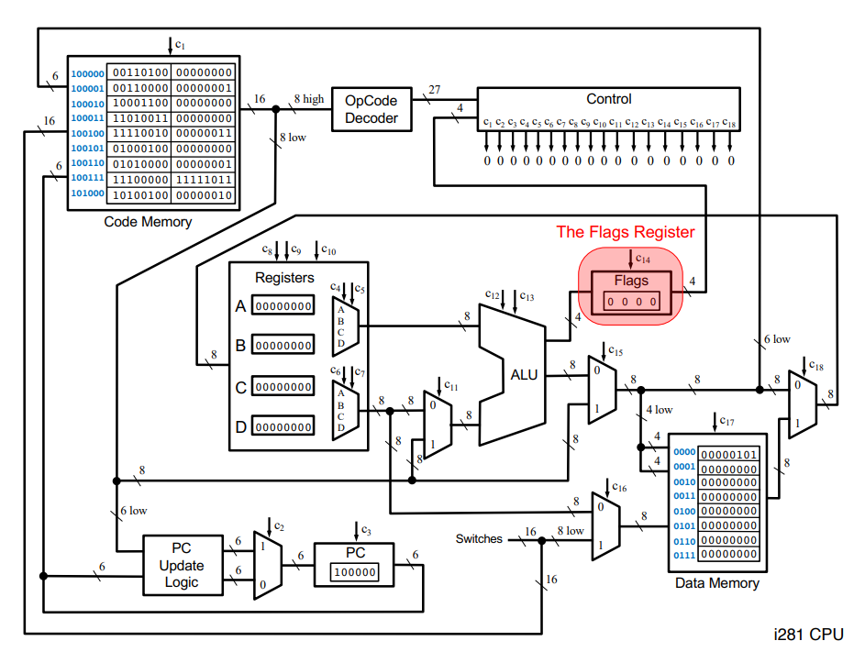
Notes:
Speaker: Pat

Slide 29
ALU and Flags Register in Full Implementation
Notes:
Speaker: Pat

Slide 30
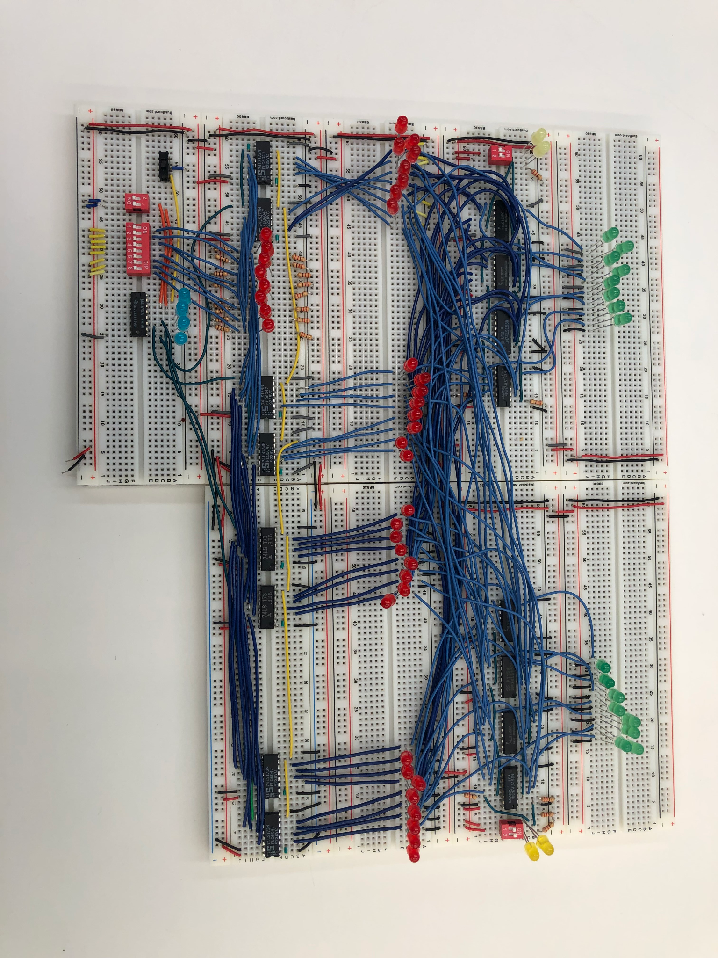
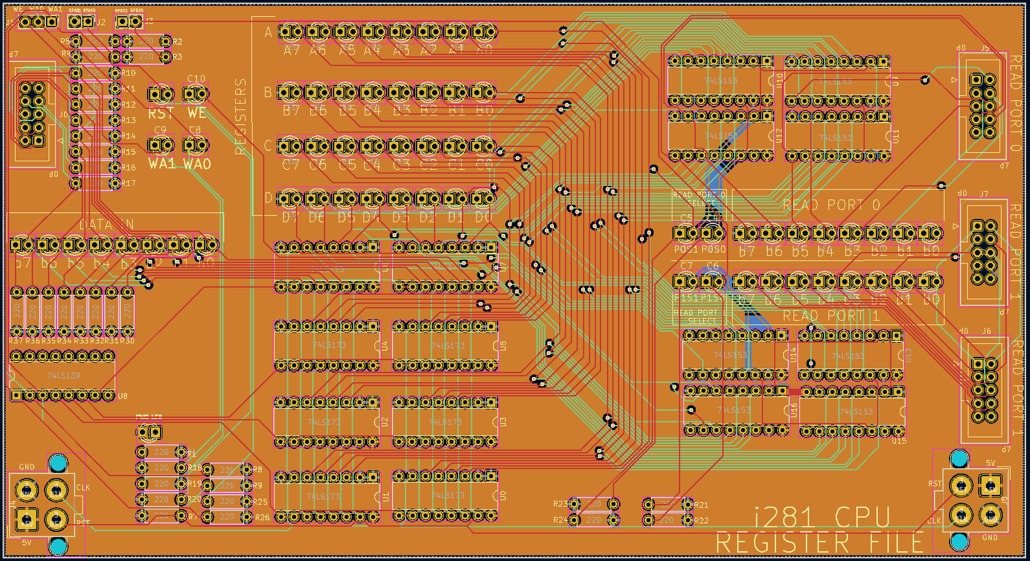
Register File
Notes:
Speaker: Alex

Slide 31
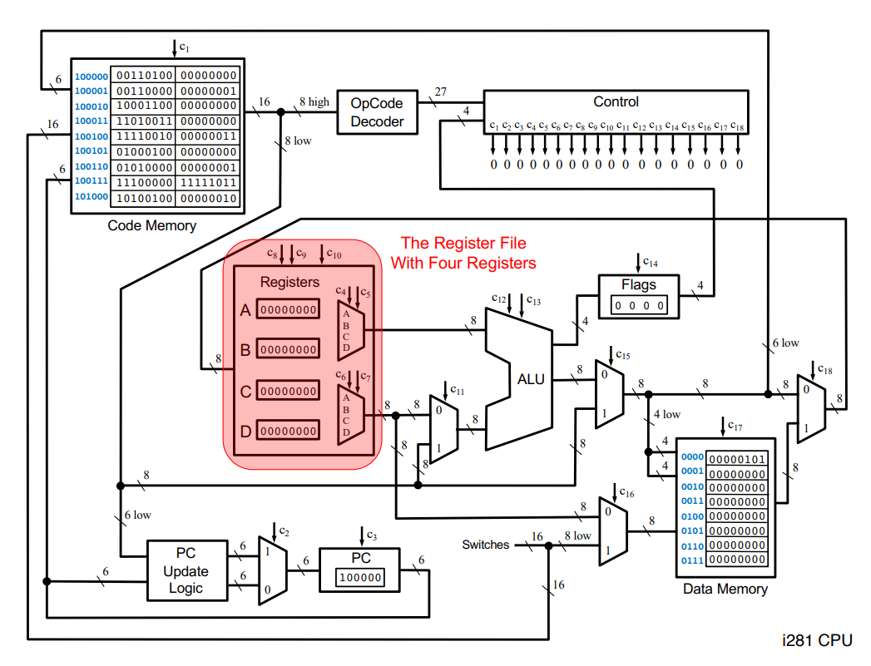
Notes:
Speaker: Alex

Slide 32
Register File in Full Implementation
Notes:
Speaker: Alex

Slide 33
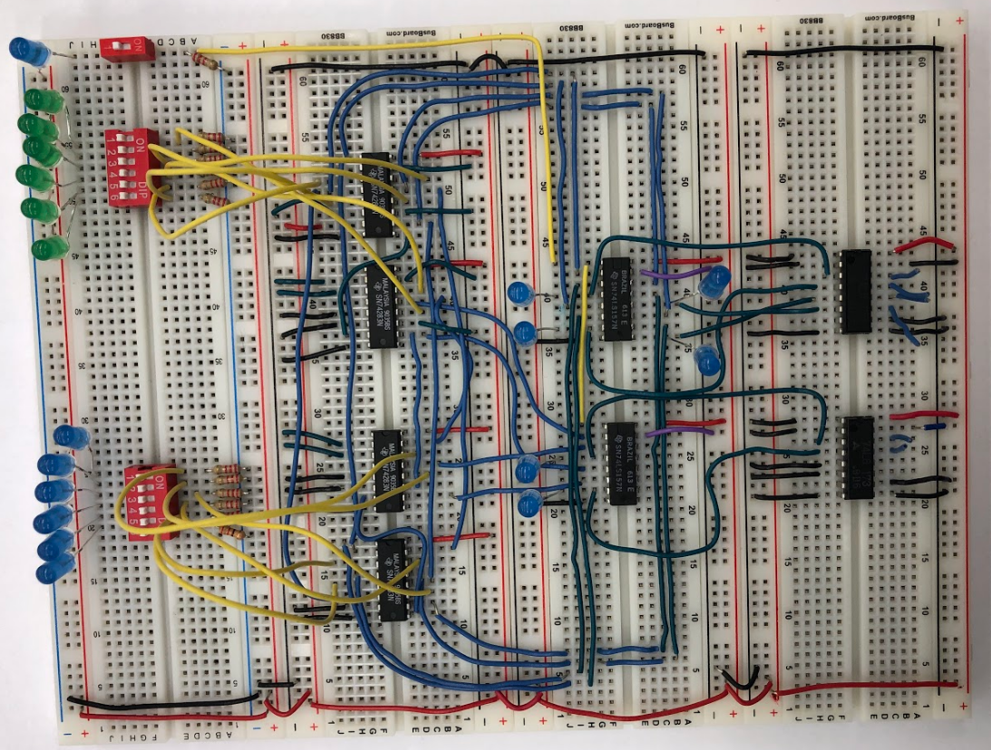
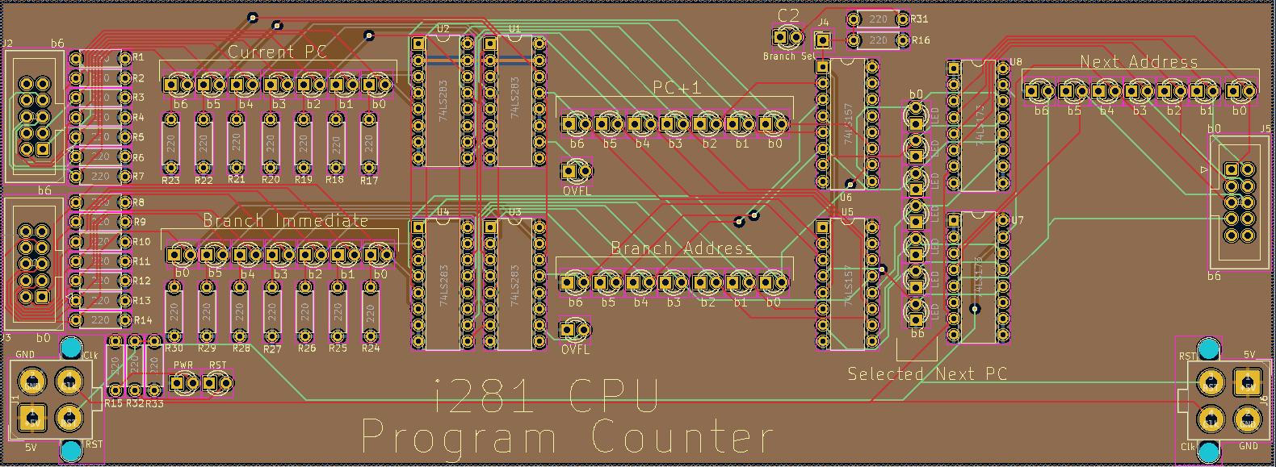
Program Counter
Notes:
Speaker: Alex

Slide 34
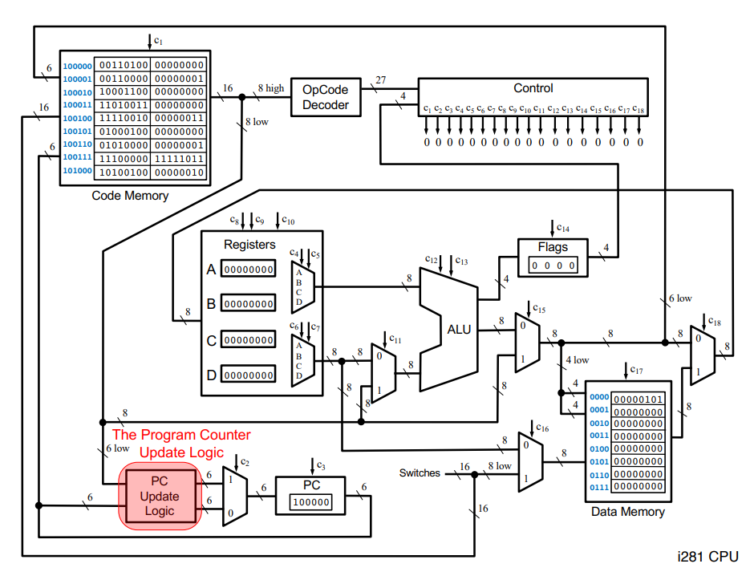
Notes:
Speaker: Alex

Slide 35
Program Counter in Full Implementation
Notes:
Speaker: Alex

Slide 36
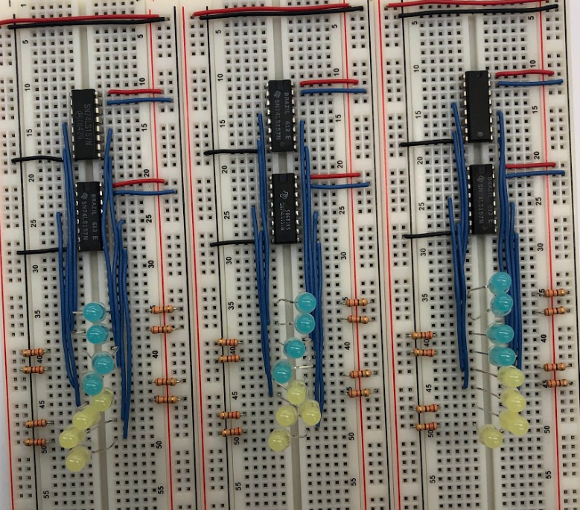
Bus Multiplexers
Notes:
Speaker: David

Slide 37
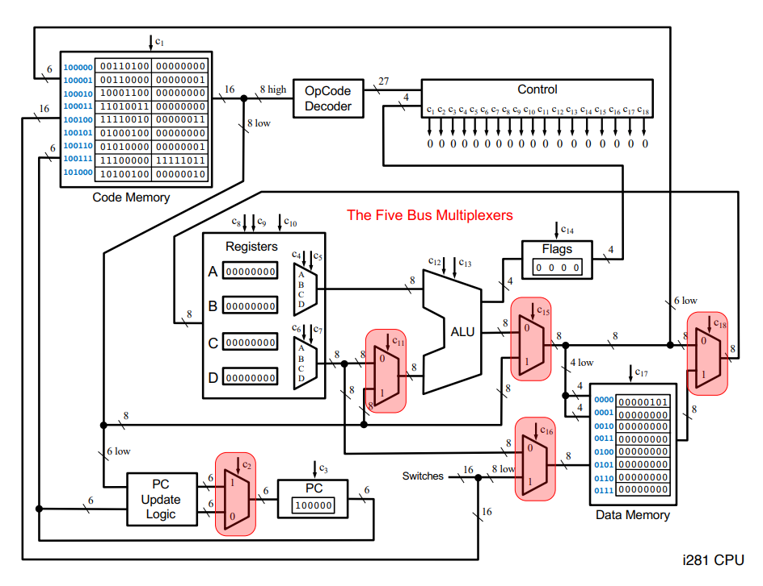
Notes:
Speaker: David

Slide 38
Bus Muxes in Full Implementation
Notes:
Speaker: David

Slide 39
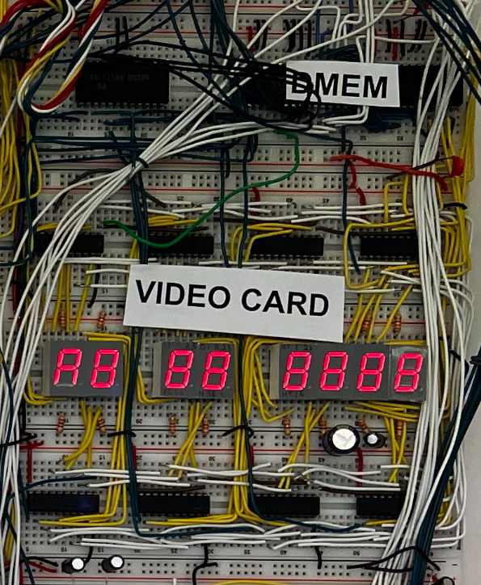
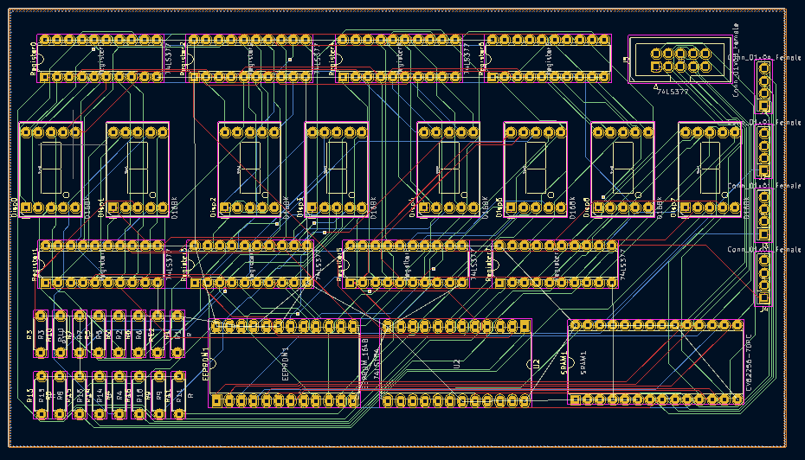
Data Memory
Notes:
Speaker: Joe

Slide 40
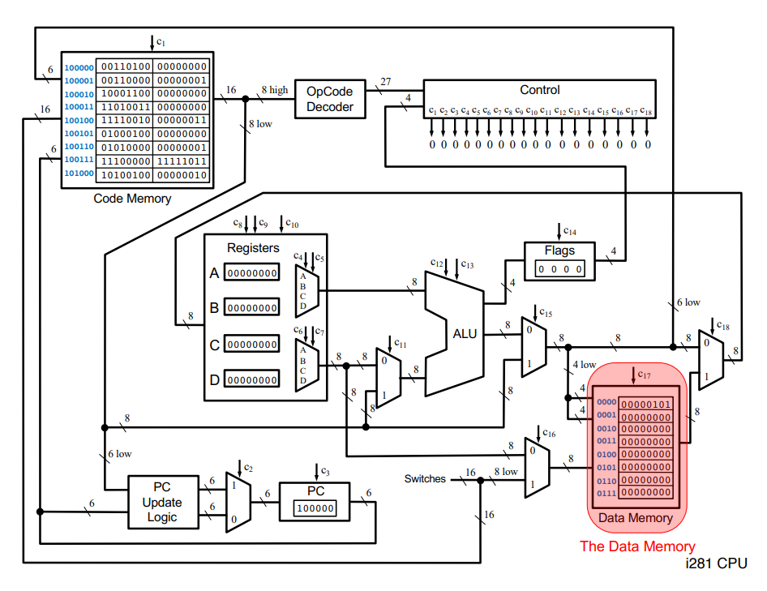
Notes:
Speaker: Joe

Slide 41
Data Memory In Full Implementation
Notes:
Speaker: Joe

Slide 42
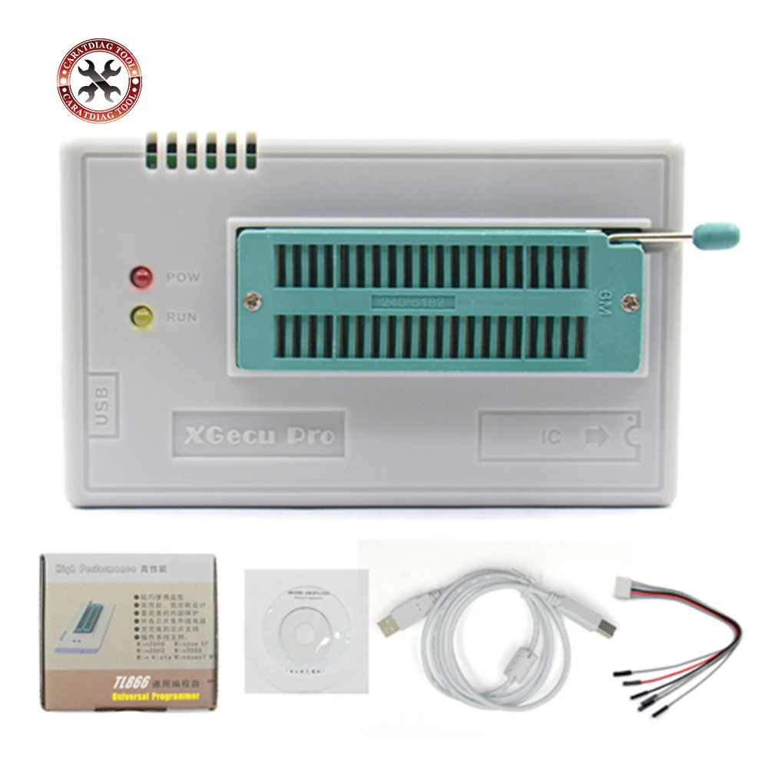
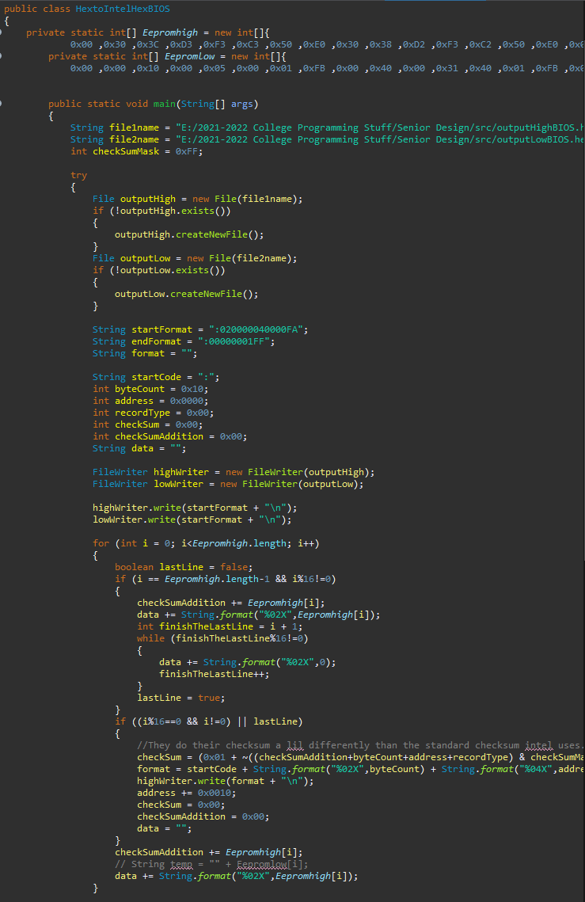
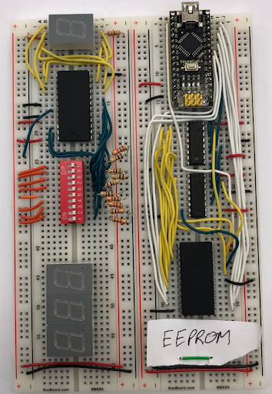
EEPROM programming
EEPROMs had to be loaded with test data
Four sets of EEPROMS to be loaded
BIOS
Control Table
Hard Disk
Video Card
EEPROMs were separated into high and low chips
Two methods to program
Xgpro software
Arduino
For Xgpro: special type of Intel hex
Had to develop java program to convert to special version of Intel hex
For Arduino
Hex could be loaded without conversion
Complicated by limited memory of arduino
This software was packaged up and uploaded to our git repository
Notes:
Speaker: David

Slide 43
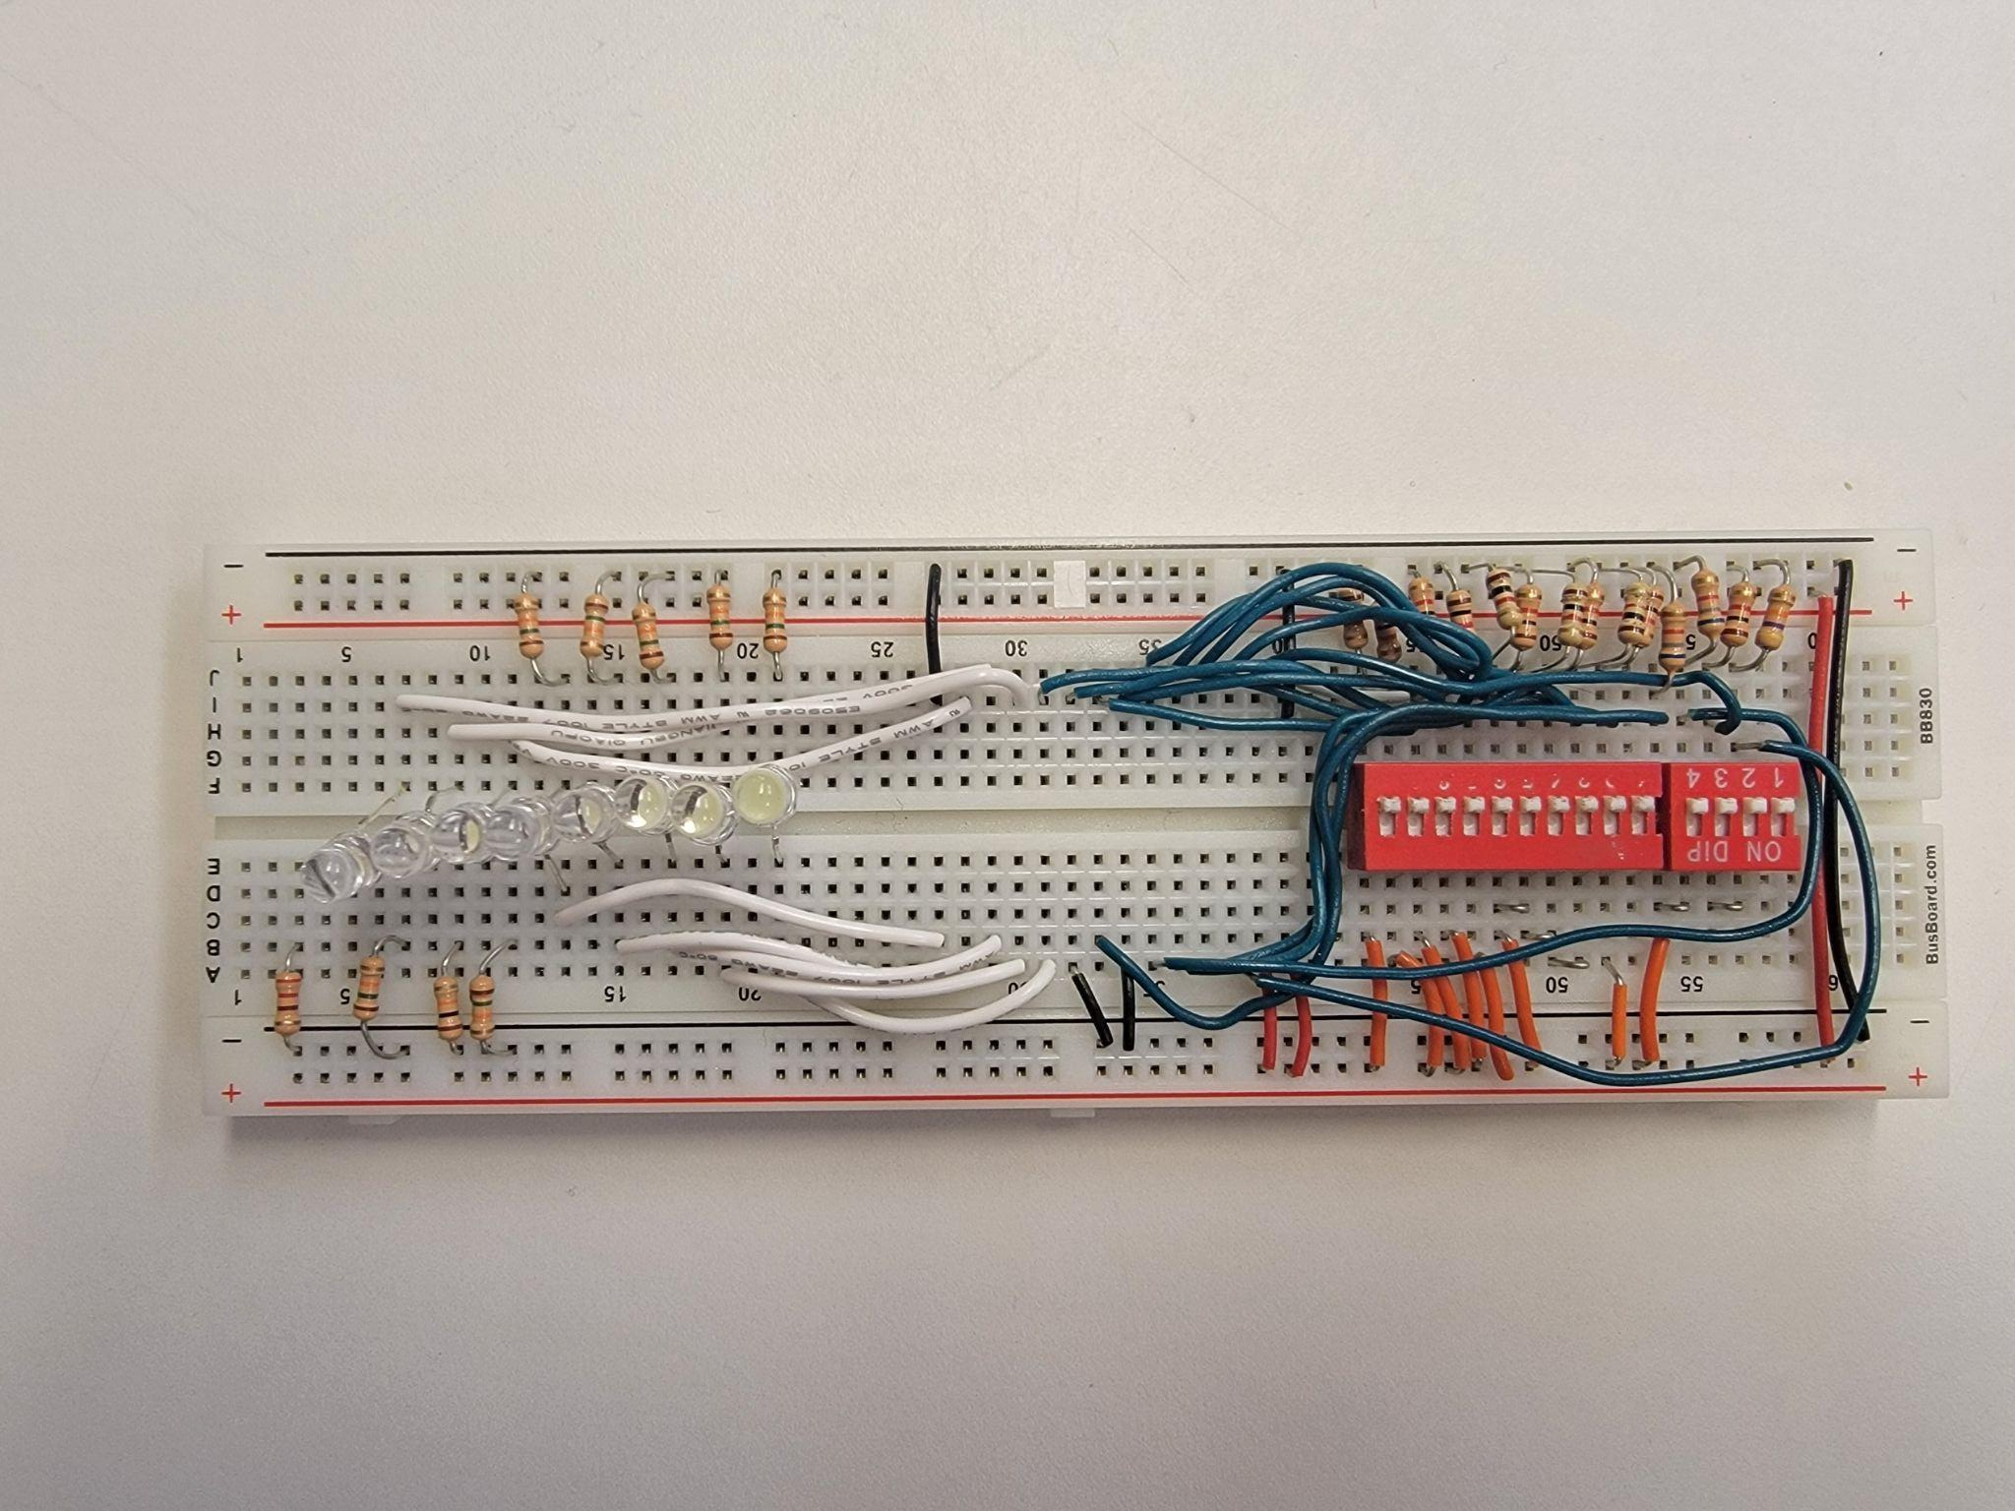
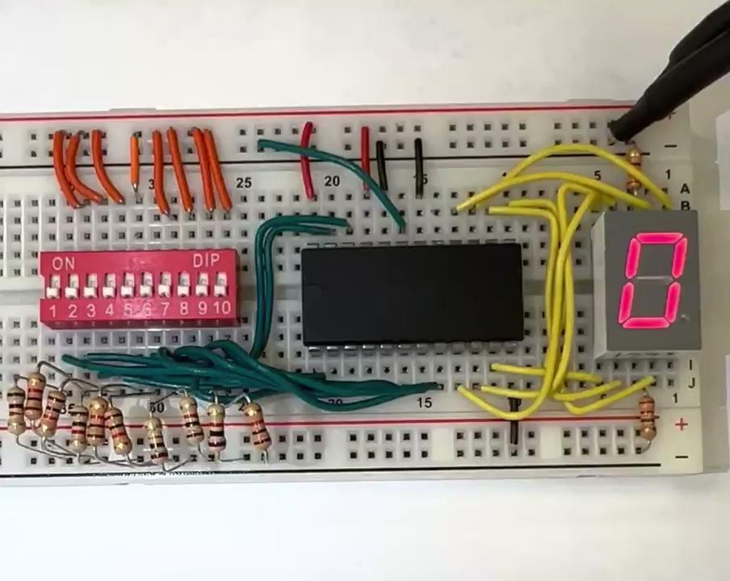
EEPROM Testing
Notes:
Speaker: David

Slide 44
Last Semester
CURRENT STATUS
Completed Modules:
7 Segment Displays
Bus Multiplexers
Register File
ALU
ALU Flags
PC Update Logic
EEPROM Program
Modules Connected
Data Path implemented
EEPROMs programmed
Testing implementation
Debugging implementation
Notes:
Speaker: Saffron

Slide 45
Future Plans
Notes:
Speaker: Saffron

Slide 46
Next Steps
i281 Clock module
Future senior design team will pick up where we left off
Will likely finish the PCB implementation using our work
Our project acted as a beta test for a possible new lab-based class
Notes:
Speaker: Saffron

Slide 47
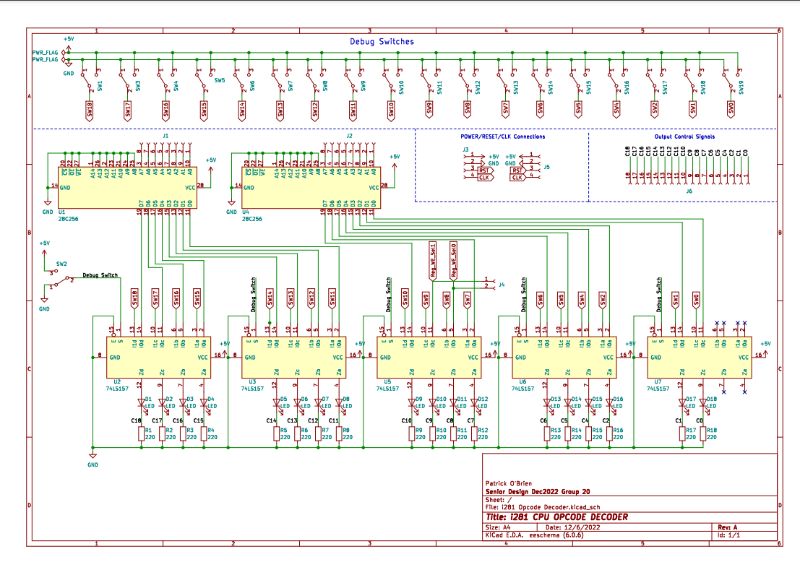
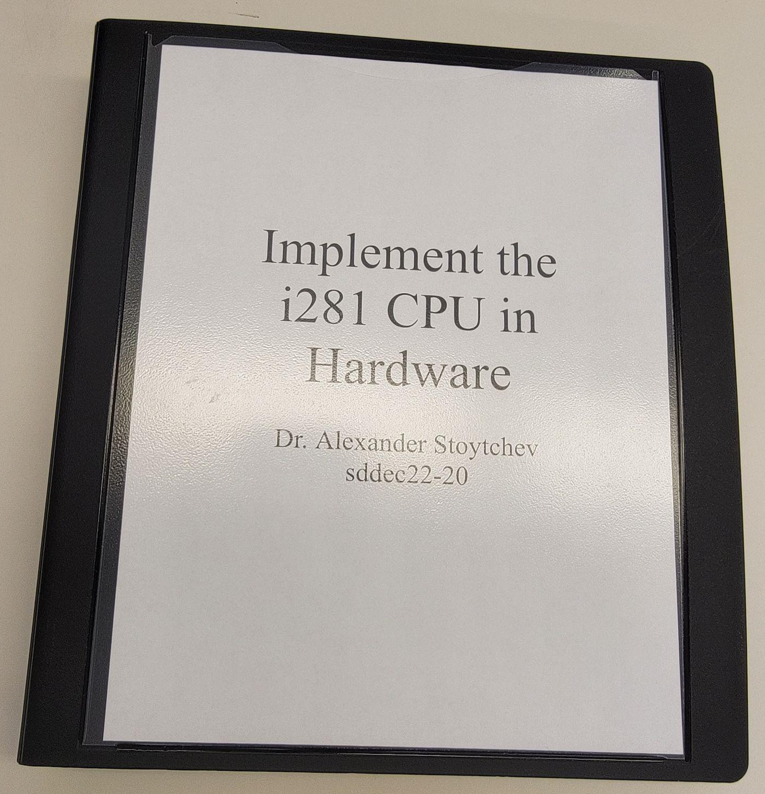
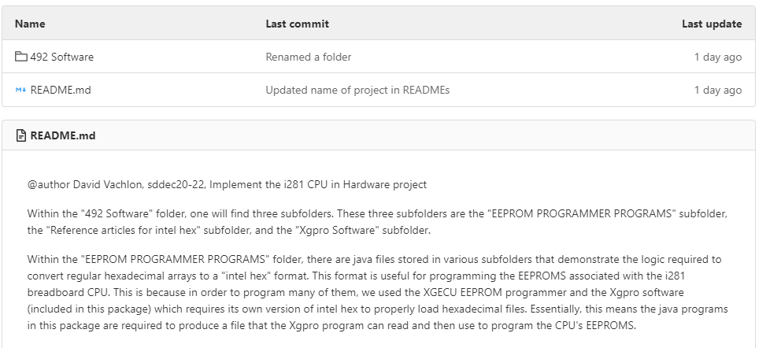
Preparation for Next Steps
Documentation binder was made as a reference for future use
EEPROM software was packaged
KiCad schematic diagrams were organized into a folder for easier future reference
Notes:
Speaker: Saffron

Slide 48
Lessons Learned
Bugs occur in design no matter if it is software or hardware
Mistakes can be difficult to trace/solve
Clear documentation makes problem-solving easier
Clear implementation plans pay off in the end
Real time to complete is almost always longer than estimated
Necessary to work as a team to delegate tasks
Plan time for debugging
Notes:
Speaker: Saffron

Slide 49
Meet the Team
i281 CPU: sddec22-20
Notes:
Speaker:

Slide 50
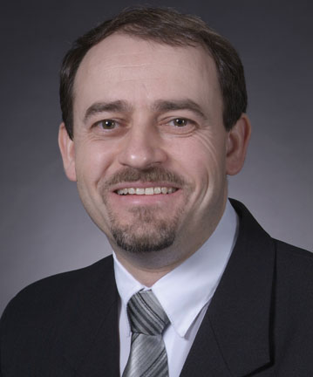
The Team
Dr. Alexander Stoytchev : Advisor and Client
Joseph DeJong (EE): Administrative Lead
Saffron Edwards (SE): Software Lead
David Vachlon (CPRE) : Interface Design
Alex Kiefer (EE): Hardware Lead
Patrick O’Brien (EE): Hardware Design
Notes:
Speaker:

Slide 51
Questions?
i281 CPU: sddec22-20
Notes:
Speaker: Pat

Slide 52
Additional Content

Slide 53
Technical Standards
IEEE Standards:
1012-2016: System, Software, and Hardware Verification and Validation
Test hardware and run i281 assembly on our computer
162-1963: Definitions of Terms for Electronic Digital Computers
Standard for component names and terms across our project and industry
i281 CPU: sddec22-20
Notes:
Speaker: Alex

